Slide 1
The Best Place for a New Juice Bar in New York
APPLIED DATA SCIENCE CAPSTONE: FINAL ASSIGNMENT
Pop-Ducheva Ina
May, 2020

Slide 2
1.Introduction
New York hospitality industry sphere is one of the most competitive in the world. It seems like every day a restaurant is opening at one place and another one is being closed and repurposed into something else.
85% of new restaurants close in the first 3 years.
Many factors can contribute to the success of a food place, such as innovation, marketing, social media presence and location.
LOCATION, LOCATION, LOCATION!

Slide 3

2. Data Acquisition and Cleaning
The dataset of venues and their description and location is available through the FourSquare Places API. From the FourSquare database we will import the information on the location including: Coordinates, Name of Venue, Address, Borough, Neighborhood etc.
2996 venues and in the dataset, which include venue name, latitude, longitude, borough, neighborhood, address, venue category.
StandardScaler()

Slide 4
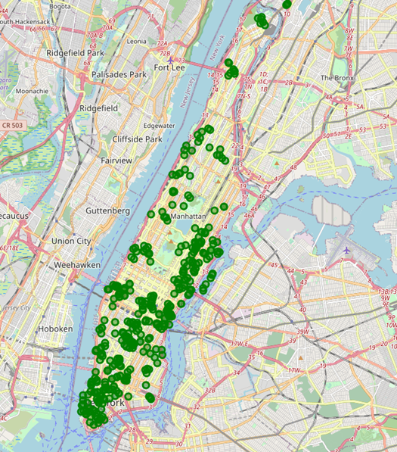
3. Metodology
How to determine the best location?
As an indicator of potential customers, we will target venues related to sports activities and healthy lifestyle shops.
There is a total of 398 places which fall into
the categories of interest shown
on the map of Manhattan Island in green.

Slide 5
3.2 DBSCAN Clustering
DBSCN is a clustering algorithm that can identify any arbitrary shaped cluster without getting affected by noise from inconsistent data and error values.
DBSCAN eliminates outliers, in our case isolated positions so that they don’t drag the center of our desired clusters.
Radius=150m
Min neighbors=10

Slide 6
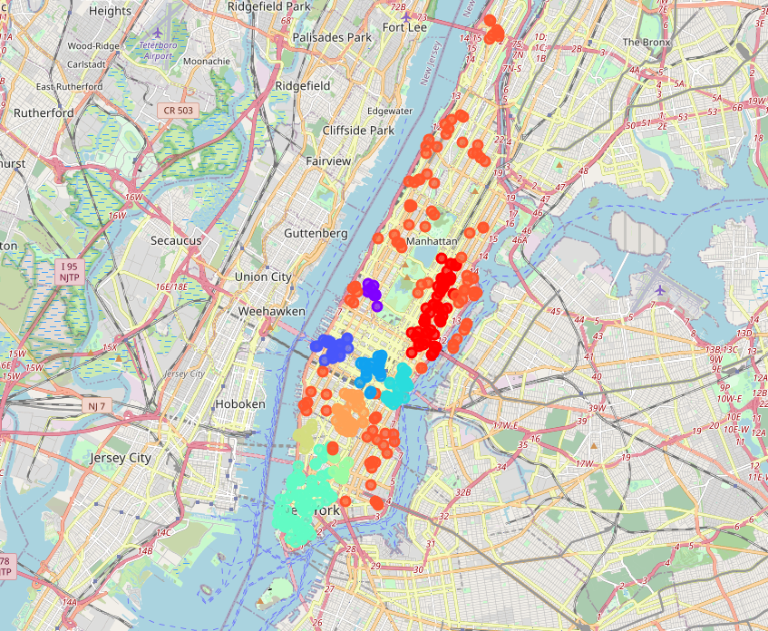
4. Results
By using the DBSCN we separate the points of interest into 10 clusters, to identify the areas with the highest density of points of interest.

Slide 7
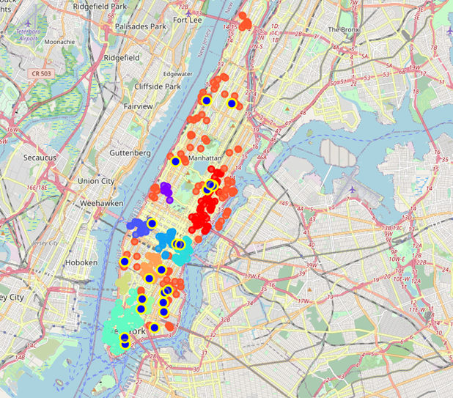
5. Discussion
If we cross-refference the locations of existing juice bars in Manhattan marked in blue and yellow and the clusters of points of interest we can gain an insight in lay out and connection of juice bars

Slide 8
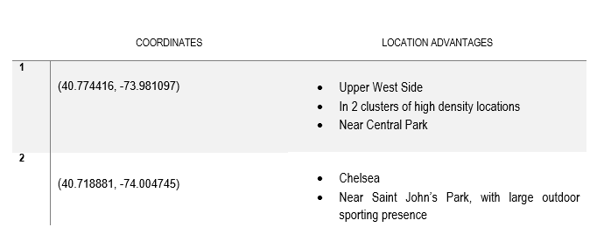
6. Conclusion
From these arguments we can draw some conclusions on the most optimal location to set up a juice bar considering maximizing the number of potential customers nearby and minimizing the competition of other venues that sell similar product to ours.
The best location for the business are in the vicinity of the following coordinates:

Slide 9
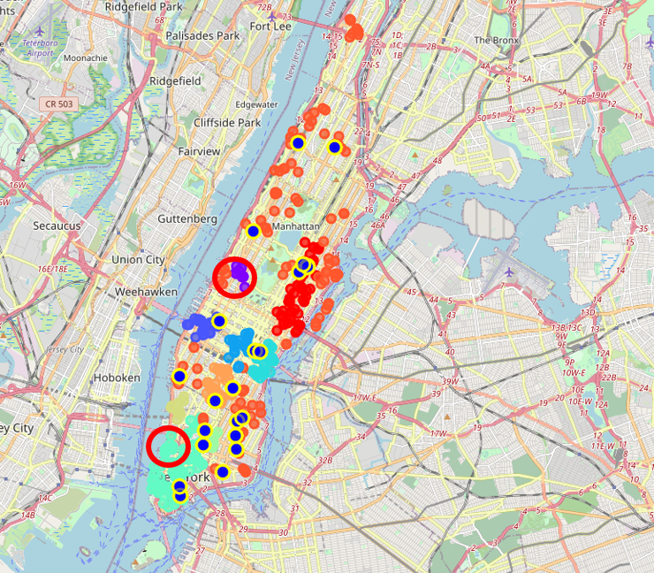
6. Conclusion
The optimal locations areas are marked with red circles in the picture below.

Slide 10
THANK YOU FOR YOUR ATTENTION

